Slide 1

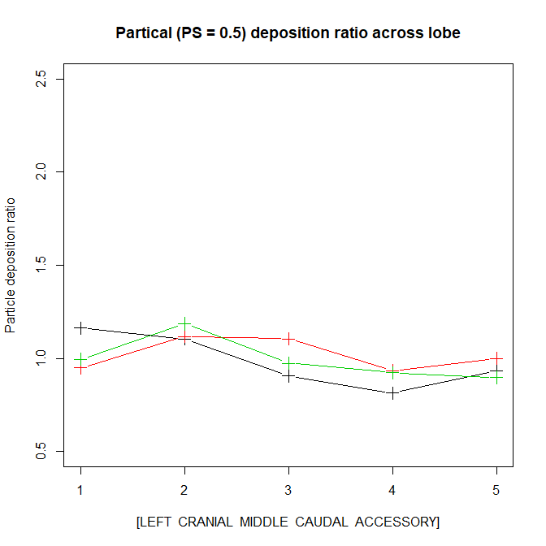
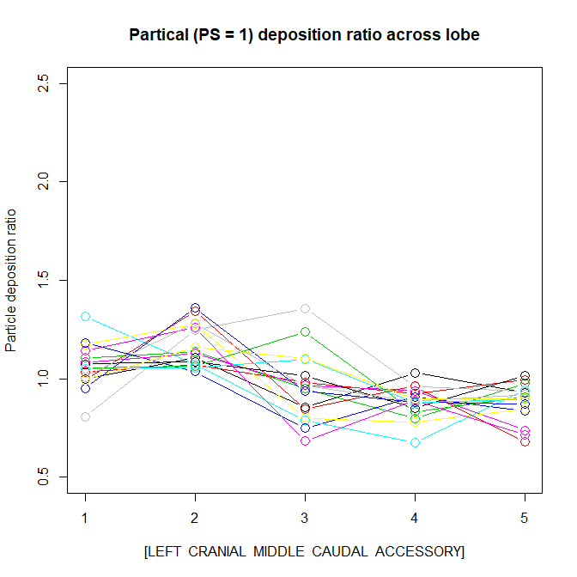
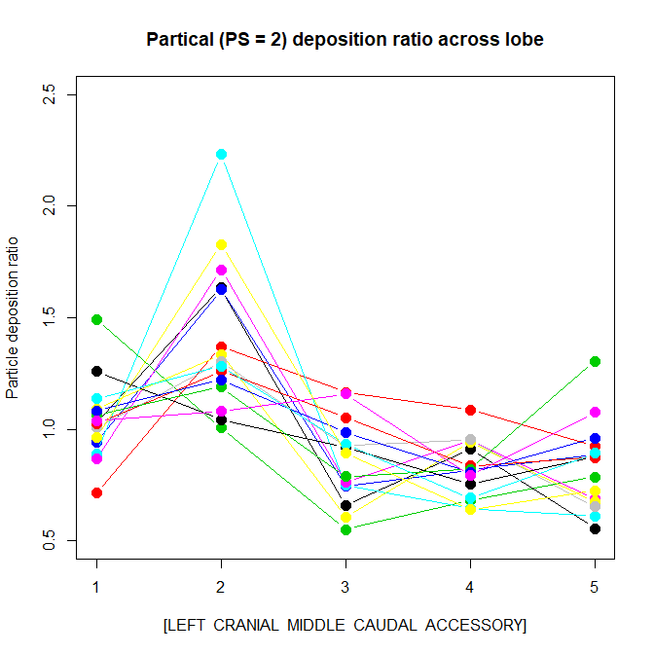
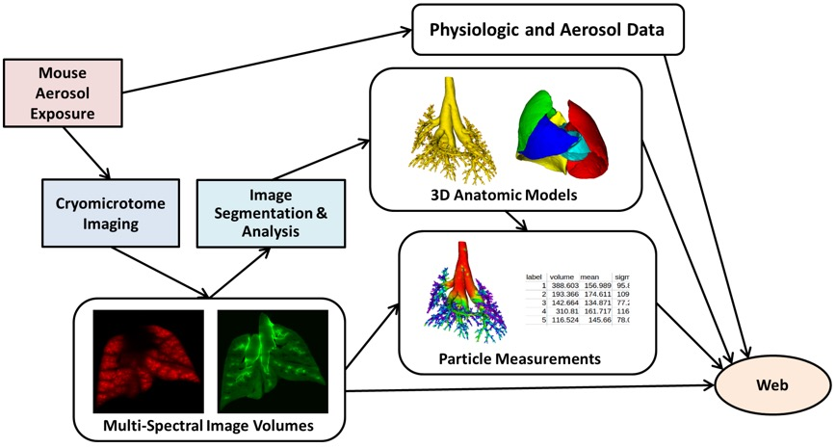
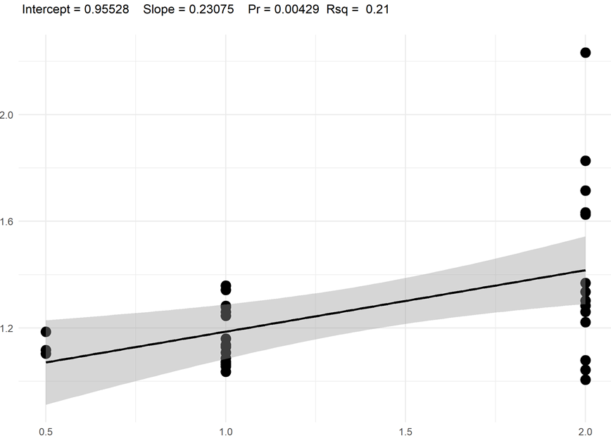
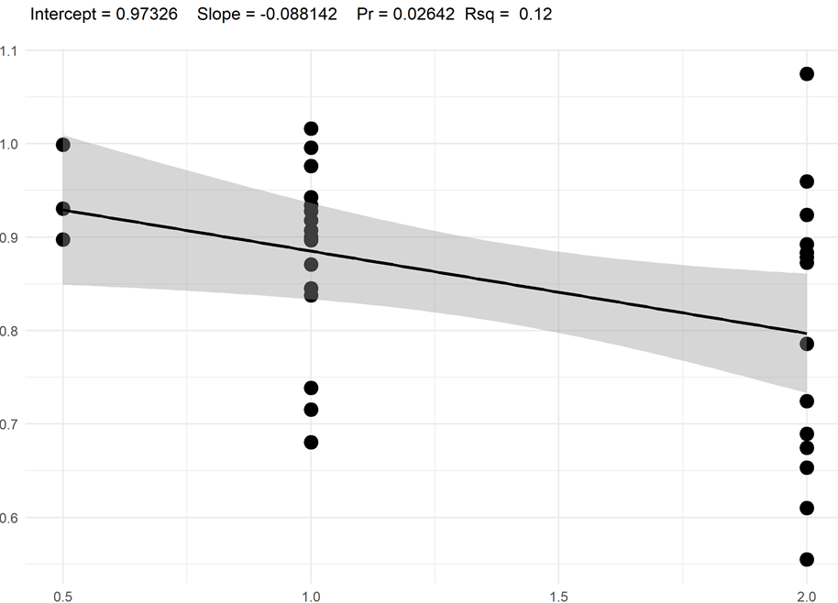
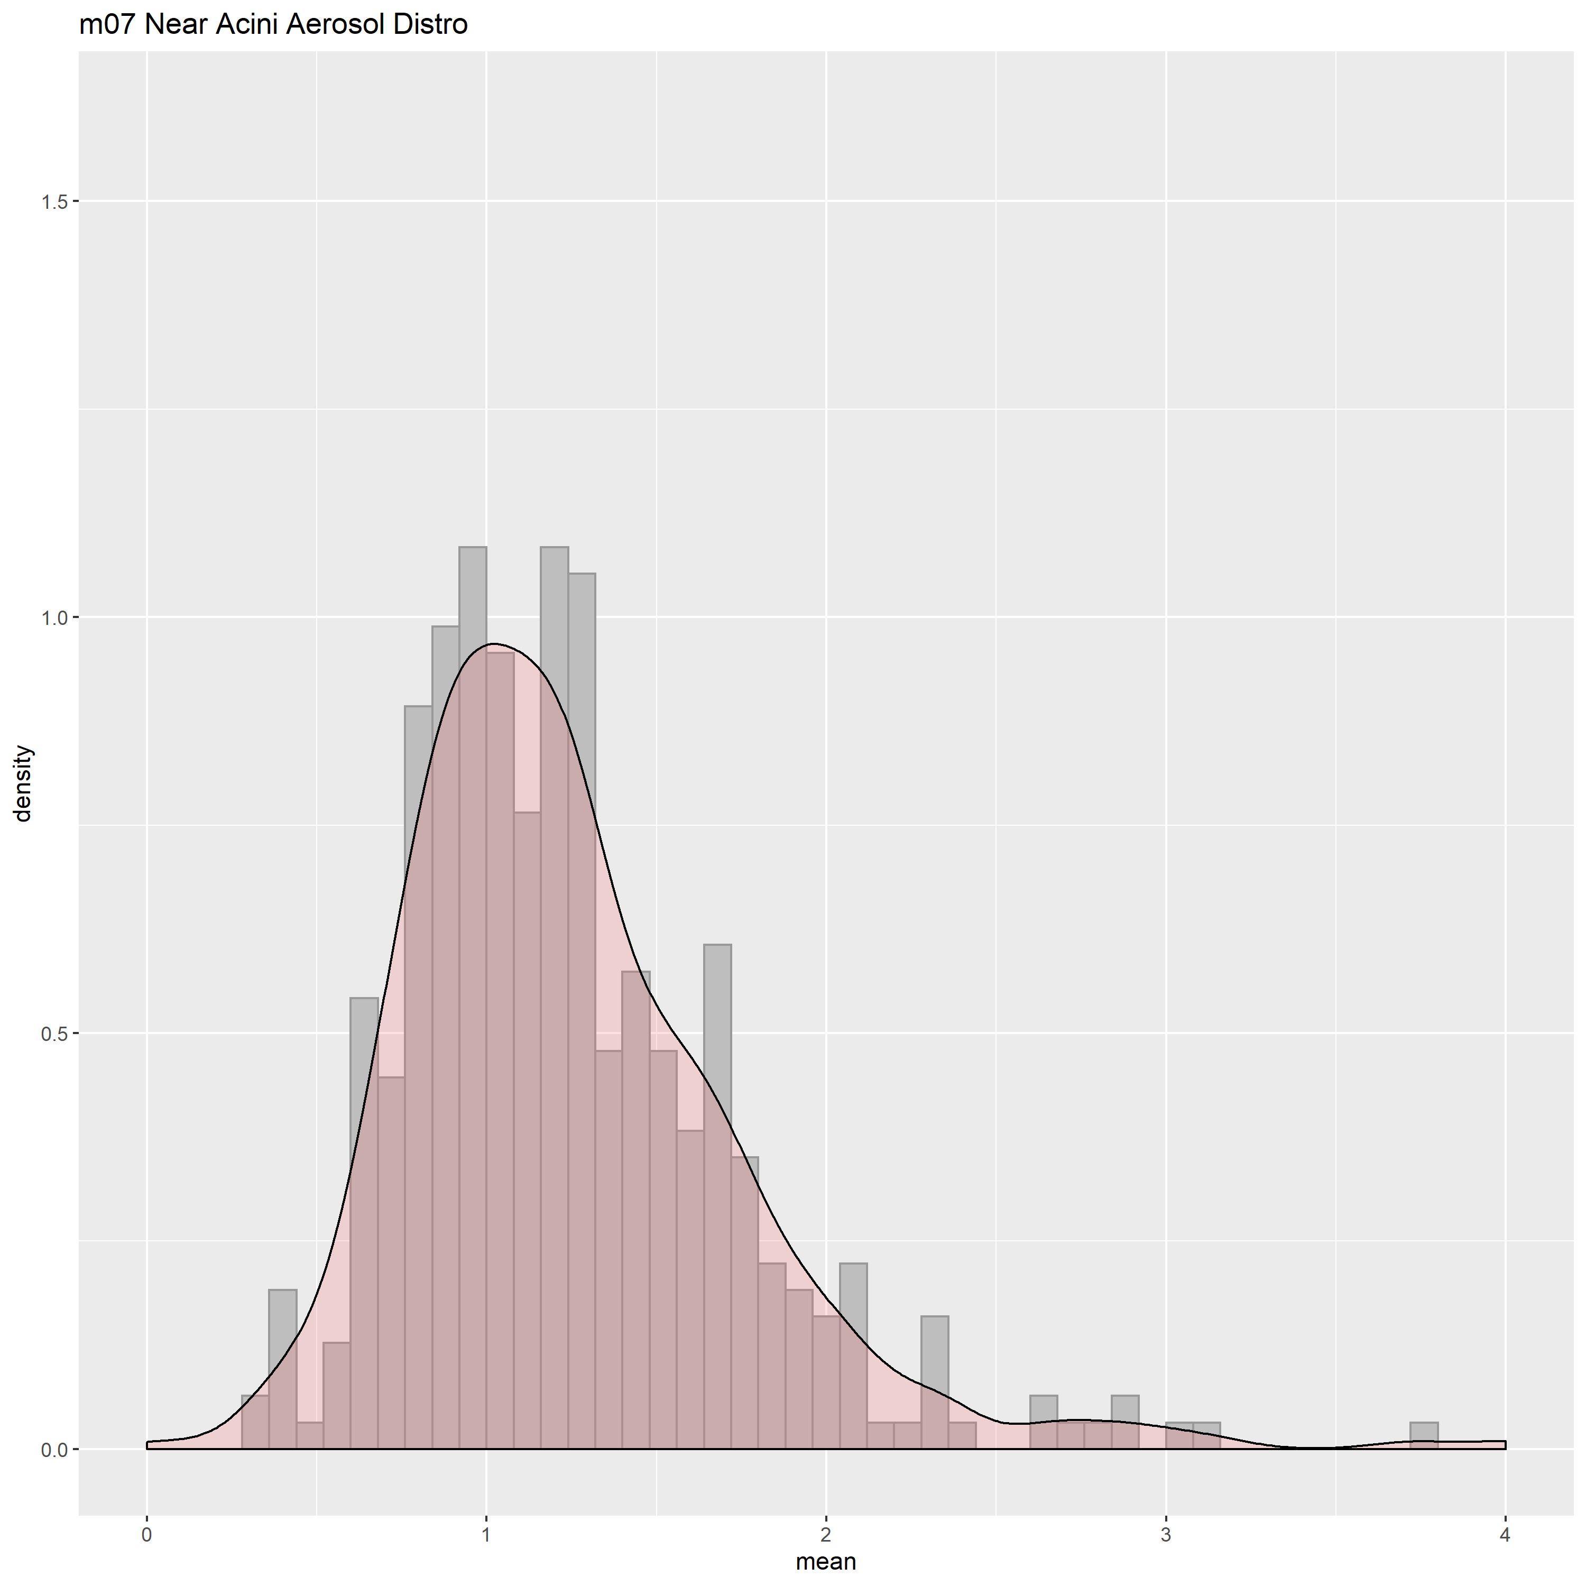
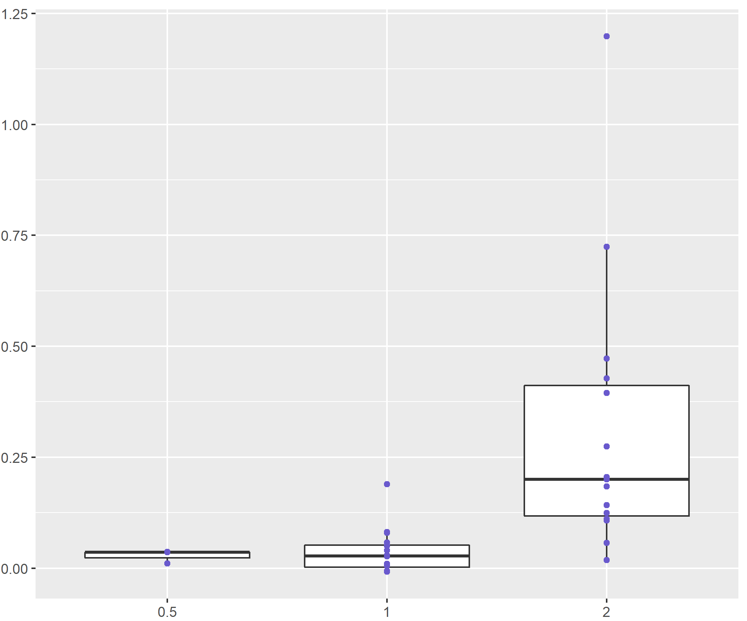
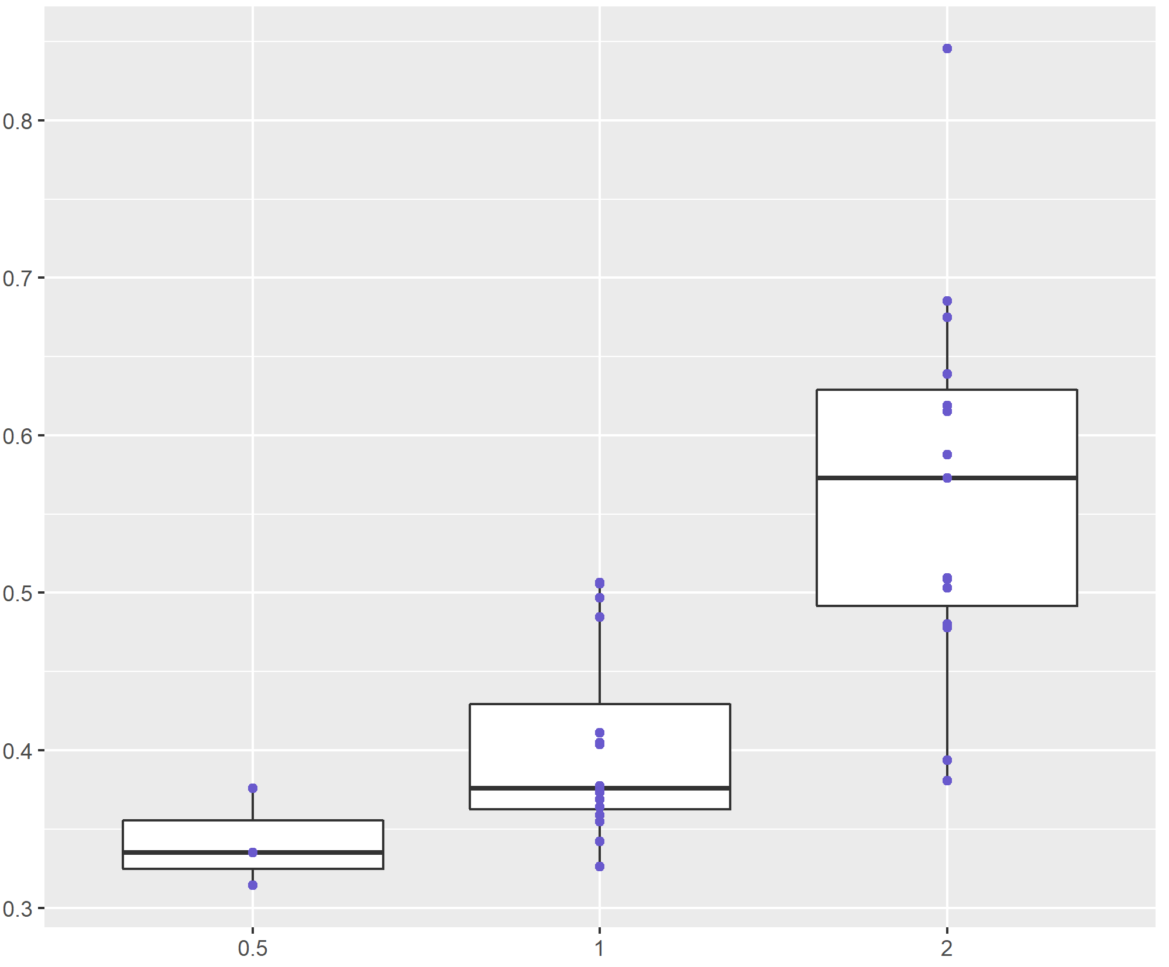

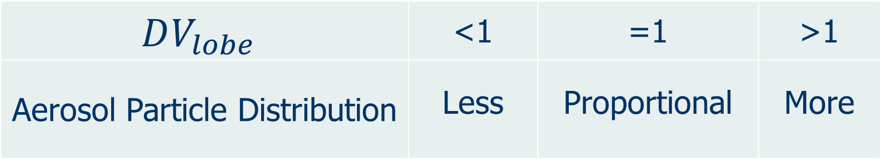
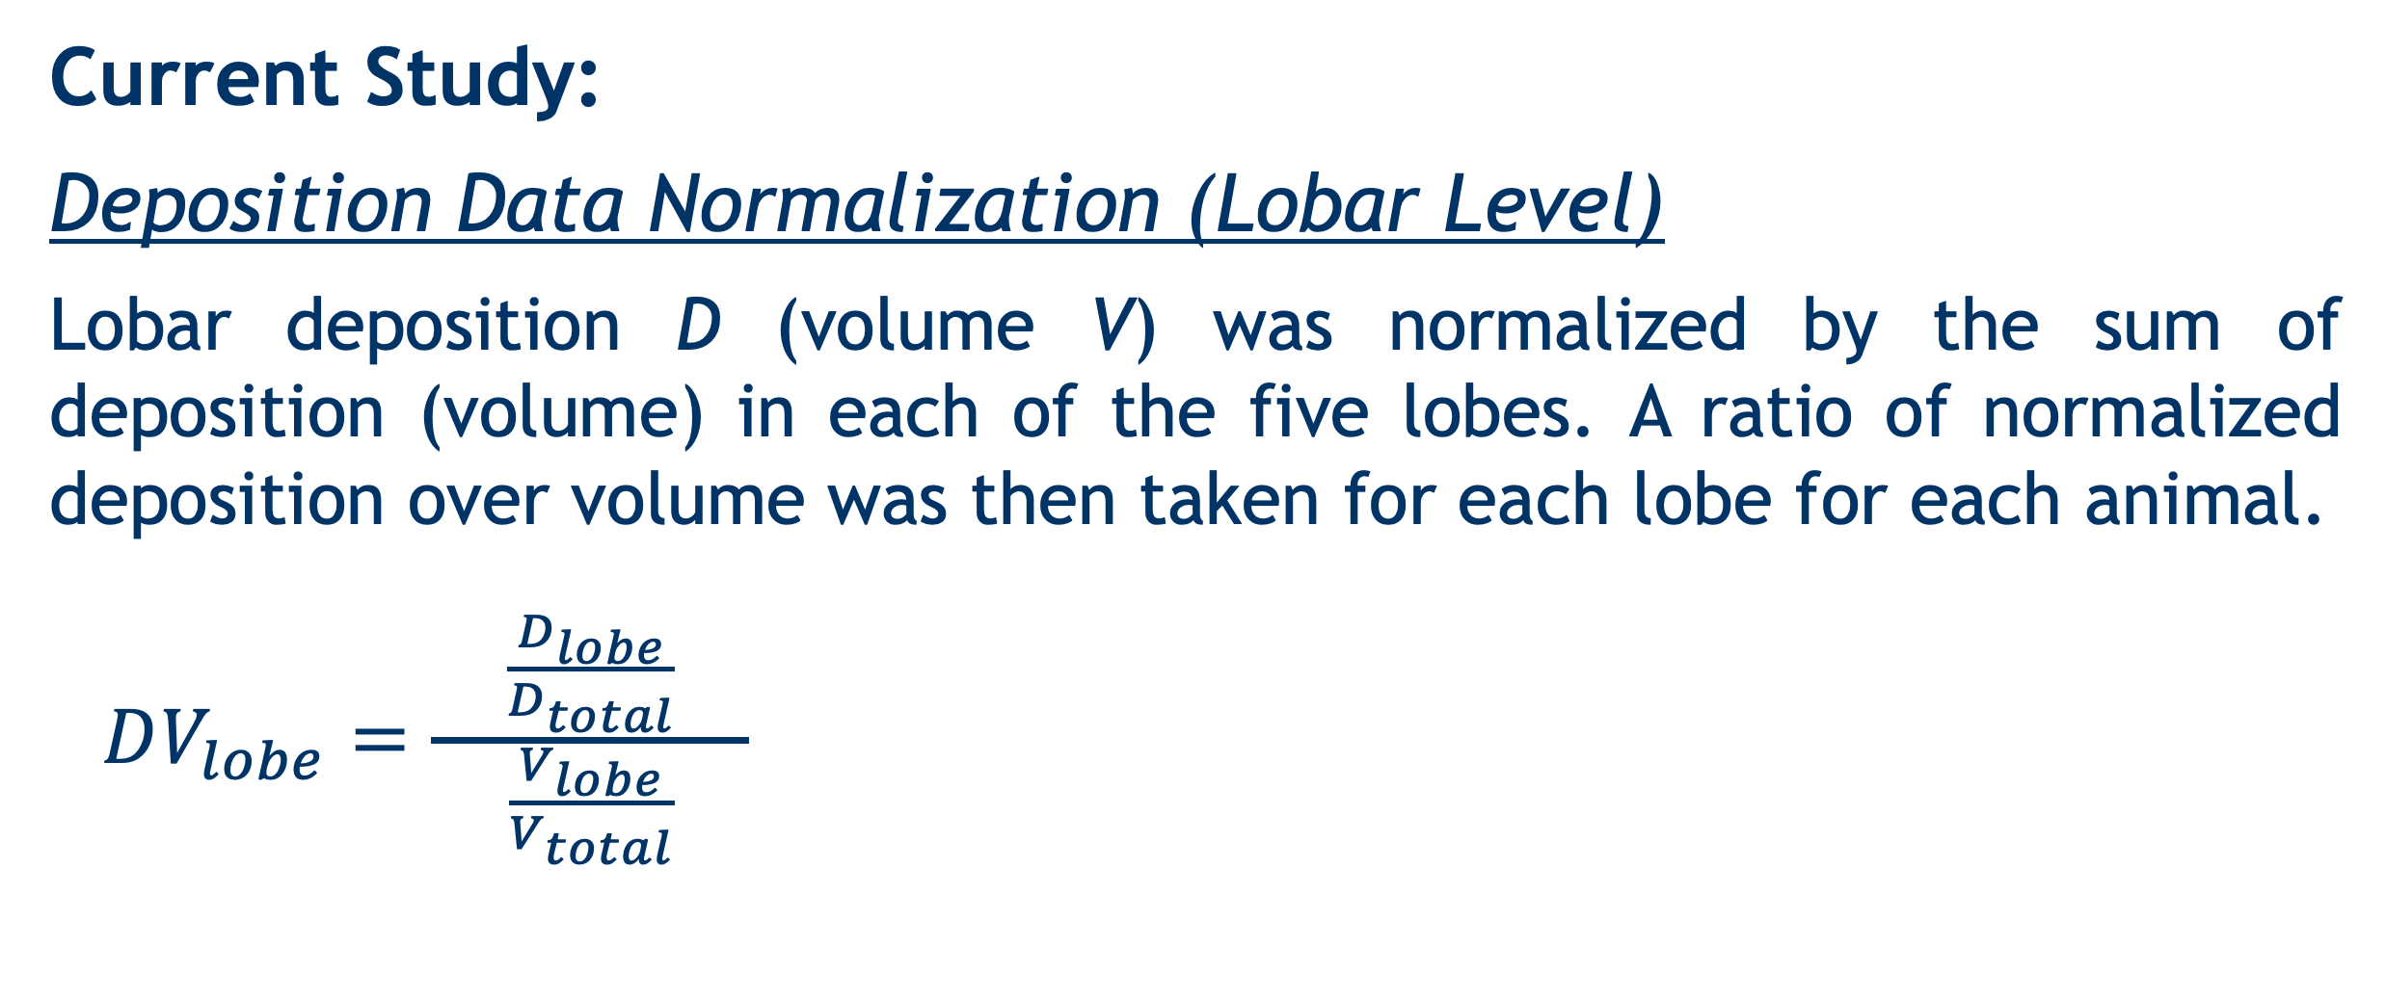

Lobar deposition of inhaled aerosol in the mouse lung: preliminary analysis of the LAPD dataset Wanjun Gu, Chantal Darquenne Department of Medicine, University of California, San Diego
BACKGROUND
RESULTS AND DISCUSSION
Aerosol-inhalation drug delivery research, due to its potential health risk, is usually carried out on laboratory animals, most commonly mice.
A unique database, Lung Anatomy + Particle Deposition Mouse Archive (LAPD) has been recently made available to the research community. This dataset includes both high resolution lung anatomy and deposition data in four strains of mice.
One of the major constraints of previous studies in this field has been lack of data on both lung anatomy and deposition distribution in the same animals.
Figure 1. DV Ratio Across Lobe for each particle size
0.5 µm
1 µm
2 µm
DV Ratio
OBJECTIVES
Left
Cranial
Middle
Caudal
Accessory
Left
Cranial
Middle
Caudal
Accessory
Left
Cranial
Middle
Caudal
Accessory
Heterogeneity in particle deposition increased with increasing particle size (Fig. 1).
Normalized deposition in the cranial lobe was relatively greater than normalized lobar volume (DV>1) whereas Caudal, Middle and Accessory lobes receive relatively less particle deposition (DV<1).
Left lobe deposition was approximately proportional to its volume (Table 1).
Table 1
To identify spatial heterogeneity of aerosol deposition in lungs on a lobar scale and determine correlations between the heterogeneity and particle size.
Particle Size | DV Ratio
 | Left | Cranial | Middle | Caudal | Accessory
1 Micron | 1.06±0.11 | 1.17±0.11 | 0.96±0.18 | 0.88±0.08 | 0.88±0.10
2 Micron | 1.04±0.18 | 1.42±0.34 | 0.86±0.19 | 0.82±0.13 | 0.80±0.15
METHODS
LAPD Study Overview:
A positive (negative) correlation was found between particle size and DV_{cranial} (DV_{accessory}) (Fig. 2).
The skewness and standard deviation of each animal deposition distribution (Fig. 3) were both positively correlated with particle size (both p ≈ 0, Fig 4).
Table 1
$$DV_{Cranial} Ratio$$
$$DV_{Accessory} Ratio$$
From: https://lapdmouse.iibi.uiowa.edu/
Available datasets:
Particle Size | Strain and Sex |  |  |  |  |  |  |  | Total
 | B6C3F1 |  | BALB/c |  | CD-1 |  | C57BL/6
 | M | F | M | F | M | F | M | F
0.5 µm | - | - | 1 | 2 | - | - | - | - | 3
1.0 µm | 2 | 2 | 2 | 2 | 2 | 2 | 2 | 2 | 16
2.0 µm | 2 | 2 | 2 | 2 | 1 | 2 | 2 | 2 | 15
* One sample was omitted during the analysis due to bad quality |  |  |  |  |  |  |  |  | 34
The positive correlations shown in Fig. 4 indicate that larger particle size is
Particle Size
Figure 2
Particle Size
correlated to higher likelihood of the formation of hot spots and bigger heterogeneity in spatial distribution of aerosol particles.
Near Acini Aerosol Deposition
(M07)
Skewness Vs. Particle Size
Standard Deviation
Vs. Particle Size
From: https://lapdmouse.iibi.uiowa.edu/Data/
Current Study:
Deposition Data Normalization (Lobar Level)
Lobar deposition D (volume V) was normalized by the sum of deposition (volume) in each of the five lobes. A ratio of normalized deposition over volume was then taken for each lobe for each animal.
$DV_{lobe}=\frac{\frac{D_{lobe}}{D_{total}}}{ \frac{V_{lobe}}{V_{total}} }$
Distribution Density
Skewness
Standard Deviation
$$DV_{lobe}$$ | <1 | =1 | >1
Aerosol Particle Distribution | Less | Proportional | More
Average Normalized Deposition
Particle Size
Particle Size
Figure 3
Figure 4
Spatial Distribution of Deposited Particles (Near Acini Level)
CONCLUSIONS
For each animal subject, histogram showing statistical distribution of normalized particle deposition at near acini level was constructed (Fig. 3). Skewness (3rd moment) and standard deviation of the deposition distributions were then calculated.
Compartments with normalized deposition higher than 4 were grouped into one bin.
For each animal subject, larger skewness of the distribution is correlated with higher likelihood of the existence of hot spots.
Analysis was performed on the newly available database, LAPD to determine the spatial heterogeneity of aerosol deposition at lobar scale and near-acini scale.
There was an uneven distribution of deposited particles among the lobes of the mouse lung. The unevenness increased with increasing particle size. Depending on the lobe, individual lobe analysis to determine overall deposition may either underestimate or overestimate total lung burden, at least for particles in the micron size range.
At near acini level, larger particle size was associated with higher likeness of formation of hot spots and a less uniform spatial distribution of particle deposition.
No significant differences were found with respect to strain or gender.
Partially Funded by 1U01ES028669 from the NIEHS at the NIH

